Slide 1

Chapter 5
Series: Tuple and List

Slide 2
Content
Collection data types
Function len()
Index and slicing
Check for occurrence in a Tuple or List
Methods for mutations of List and keyword del
Loop through a Tuple or List
Operators +, *, <, >, ==, is
Nested Lists
Functions tuple() and list()

Slide 3
Collection data types
There are 4 collection data types in Python. We use them when we have a collection of objects that we want to address as a whole in a program
Tuple is a collection which is ordered and unchangeable. (immutable like strings)
List is a collection which is ordered and changeable.
Set: see chapter 10
Dictionary: see chapter 10
Tuple uses ( …….. ) , List uses [ …….. ] and Set & Dictionary uses { …….. }
Tuple and List are often called sequences
Examples
a film collection
a stack of books
the days of the week
temperature measurements of the past week
…

Slide 4

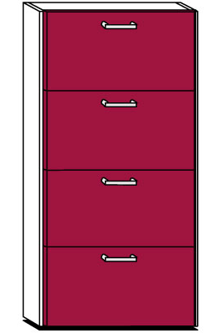
Collections
in stead of

Slide 5
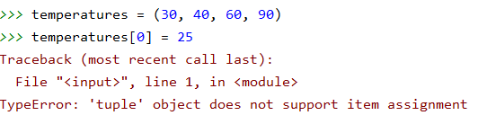
Tuple
Once created, the content of the tuple is fixed; a tuple is 'immutable'.
You cannot change or remove elements from the tuple
You can't add elements.
To create a tuple you use ( )
A tuple is immutable
0 | 1 | 2 | 3
30 | 40 | 60 | 90
temperatures = (30, 40, 60, 90)

Slide 6
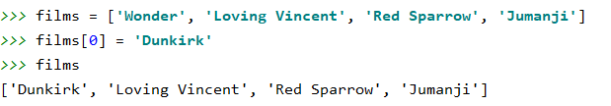
List
The content of a list can be changed at any time; a list is 'mutable'.
You can change elements in the list
You can remove elements from the list
You can add new elements to the list
To create a list you use [ ]

Slide 7


Function len() (List and Tuple)
Using the function len() you can retrieve the number of elements in a series
0 | 1 | 2 | 3
30 | 40 | 60 | 90

Slide 8
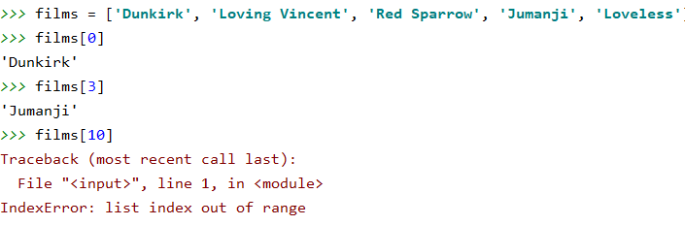
Index (List and Tuple)
Each object in the series can be addressed on the basis of its serial number or so-called index in the series.
The first item in the series has index 0
0 | 1 | 2 | 3 | 4
Dunkirk | Loving Vincent | Red Sparrow | Jumanji | Loveless

Slide 9
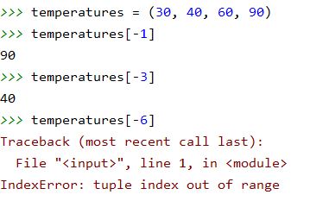
Index (List and Tuple)
You can also count the index position starting from the last element in the series.
The last element has index -1.
0 | 1 | 2 | 3
30 | 40 | 60 | 90
-4 | -3 | -2 | -1

Slide 10
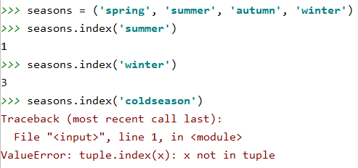
Method index (List and Tuple)
You can also search the index position of an element.
You will receive an error message when the element is not found.
When an element occurs more than once in the series, the index of the first occurrence is returned.
0 | 1 | 2 | 3
spring | summer | autumn | winter

Slide 11
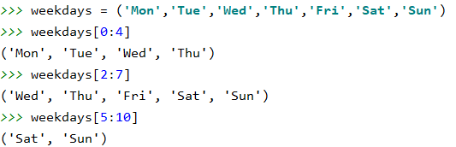
Slicing (List and Tuple)
Slicing means that via the index positions [lower limit : upper limit] you indicate which part you want to take out of the series. Lower limit is included in the selection, upper limit is not included.
The result of slicing is another series.
0 | 1 | 2 | 3 | 4 | 5 | 6
Mon | Tue | Wed | Thu | Fri | Sat | Sun
-7 | -6 | -5 | -4 | -3 | -2 | -1

Slide 12



Check for occurrence in List or Tuple
Check whether a day falls during the week or during the weekend
weekdays = ('Mon', 'Tue', 'Wed', 'Thu', 'Fri', 'Sat', 'Sun') day = input('Enter a day: ') if day in weekdays[0:5]: print('Weekday') elif day in weekdays[5:]: print('Weekend') else: print('Input not in series:', *weekdays)
element in series is a boolean expression which returns True when the element is in the range
print(*tuple) prints content without () and comma’s same for print(*list)

Slide 13
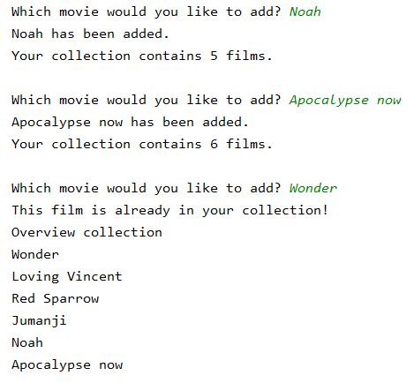
Check for occurrence in List or Tuple
Script to add new movies to your collection.
films = ['Wonder', 'Loving Vincent', 'Red Sparrow', 'Jumanji’]
Your film collection only contains unique titles. When you enter an existing film, you can no longer expand the collection.
'
Iteration!

Slide 14
Check for occurrence in List or Tuple
films = ['Wonder', 'Loving Vincent', 'Red Sparrow', 'Jumanji'] new_film = input("Which movie would you like to add? ") while not new_film in films: # PEP 8 -> while new_film not in films: films.append(new_film) print(new_film, "has been added. \nYour collection contains", len(films), "films.") new_film = input("\nWhich movie would you like to add? ") # when an existing movie is entered, we show the overview print("This film is already in your collection!") print("Overview collection") for film in films: print(film)

Slide 15
Methods for mutations of List
films = ['Wonder', 'Loving Vincent', 'Red Sparrow', 'Jumanji']
method | functionality | example and result
append | add an element at the end of the list | films.append('Loveless') ['Wonder', 'Loving Vincent', 'Red Sparrow', 'Jumanji', 'Loveless']
insert | add an element at indicated position in the list (add in front = position 0) | films.insert(2, 'Loveless') ['Wonder', 'Loving Vincent', 'Loveless', 'Red Sparrow', 'Jumanji']
remove | delete the first element of the list with the specified value | films.remove('Wonder') ['Loving Vincent', 'Red Sparrow', 'Jumanji']
pop | delete element at indicated position* | films.pop(0) ['Loving Vincent', 'Red Sparrow', 'Jumanji']
(*) when no index position is included, the last element in the list is deleted

Slide 16
Methods for mutations of List
method | functionality | example and result
sort | order the elements of the list | films.sort() [Jumanji', 'Loving Vincent', 'Red Sparrow', 'Wonder']
extend | add a second list at the end of the first | films.extend(['Loveless', 'it']) ['Wonder', 'Loving Vincent', 'Red Sparrow', 'Jumanji', 'Loveless','it']
index | look up position where element appears for the first time | films.index('Wonder') 0 films.index('Ten') ValueError Error message if no occurrences are found (*)
count | counts number of elements | films.count('Wonder') 1
reverse | reverse order of elements | films.reverse() ['Jumanji', 'Red Sparrow', 'Loving Vincent', 'Wonder']
(*) To check whether an element appears in the list, it is better to use: if 'Ten' in movies:

Slide 17
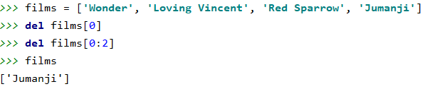
List mutation via keyword del
del is neither a function nor a method of a list but a reserved Python keyword
Via del you can remove an element or a series of elements from a list based on the index.
Exact position
From start position to end position (not included)

Slide 18
Loop through a List or Tuple
To address all elements of a series one by one, for example to print them, you use an iteration.
2 possibilities: FOR and WHILE
FOR
for loop # for <element> in <collection> :
for loop with range # for i in range(len(<collection>):
WHILE
while structure using the index position

Slide 19
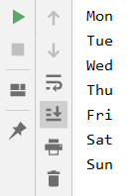
Simple loop through a Tuple
Example of a for loop
weekdays = ('Mon', 'Tue', 'Wed', 'Thu', 'Fri', 'Sat', 'Sun')
for day in weekdays: print(day)
Using the variable day, the tuple is run from index 0 up to and including index 6.

Slide 20
Loop through a Tuple with range
Example of a for loop with range
weekdays = ('Mon', 'Tue', 'Wed', 'Thu', 'Fri', 'Sat', 'Sun') for i in range(len(weekdays)): print(weekdays[i])
Variable i loops through the range from 0 to len (weekdays). len (weekdays) is 7, so index positions from 0 to 6 will be printed!

Slide 21
While loop through a Tuple
Example of a while loop (always uses the index)
weekdays = ('Mon', 'Tue', 'Wed', 'Thu', 'Fri', 'Sat', 'Sun') index = 0 while index < len(weekdays): print(weekdays[index]) index += 1
Variable index starts at 0. The number of elements in the series is len(weekdays) or 7.
The loop is executed as long as the variable index is less than 7. So index positions from 0 to 6 will be printed!

Slide 22
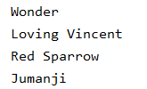
Loop through a List
A List can be looped through with a for or a while loop.
Examples if you do NOT make any changes to the List
films = ['Wonder', 'Loving Vincent', 'Red Sparrow', 'Jumanji'] for film in films: print(film) for i in range(len(films)): print(films[i]) index = 0 while index < len(films): print(films[index]) index += 1

Slide 23

Loop through a List
If you want to iterate through the List to make changes
you should NOT use a simple for loop
films = ['Wonder', 'Loving Vincent', 'Red Sparrow', 'Jumanji'] print('Before:', films) for i in range(len(films)): films[i] = films[i].upper() print('After:', films) index = 0 while index < len(films): films[index] = 'Film ' + str(index + 1) index += 1 print('After while loop:', films)

Slide 24
Initialise a List
New empty list:
new_list = []
You can fill this list:
via a loop (eventually using an input statement)
with append or insert
Make a list based on another existing list:
Remark: a Tuple is immutable so it makes no sense to start with an empty Tuple
(End of part 1 → make exercises 1 – 7 )
films = ['Wonder', 'Loving Vincent', 'Red Sparrow', 'Jumanji'] films2 = ['IT', 'Once upon a time', *films[1:-1], 'Bad Cop']

Slide 25

Part 2: Functions max, min and sum (List and Tuple)
You can use the max() and min() functions to determine the maximum and minimum respectively of a sequence consisting of numbers.
You can summerize the elements of a sequence of numeric elements using the sum() function.
r1 = (327, 419, 101, 667, 925, 225) print(max(r1)) print(min(r1)) print(sum(r1)) r2 = [12.1, 7.5, 9.9, 11.4, 12.6] print(max(r2)) print(min(r2)) print(sum(r2))

Slide 26
Operators (List and Tuple)
+ and *
teaching_days = ('Mon', 'Tue', 'Wed', 'Thu', 'Fri') lesson_hours = (3, 4.5, 6, 4.5, 3) lesson_hours_per_day = teaching_days + lesson_hours print(lesson_hours_per_day)
greek_letters = ['alpha', 'beta', 'omega'] more_letters = greek_letters * 4 print(more_letters)
Note that a sequence may contain a mix of data types: string, integer, float, ...

Slide 27
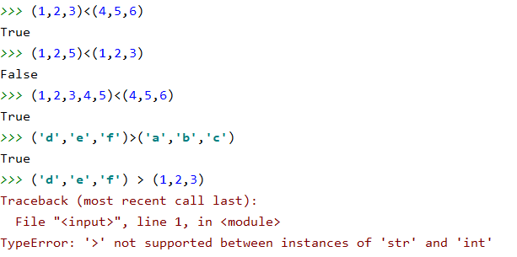
Operators (List and Tuple)
Comparison operators < and >
Only the corresponding positions are compared. The size of the series is not taken into account.

Slide 28
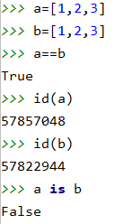
Series and operators (List and Tuple)
Comparison operator == checks if the content of the series is identical
is checks that both sets refer to the same memory location
With function id() you can retrieve this memory location
program
main memory
=
list
a
1,2,3
list
b
1,2,3

Slide 29
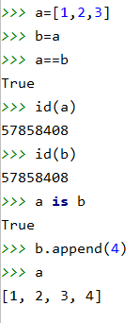
Series and operators (List and Tuple)
Comparison operator == checks if the content of the series is identical
is checks that both sets refer to the same memory location
program
main memory
=
list
1,2,3
a
1,2,3,4
b
A new memory location will only be provided if a series is assigned its own values when it is created. Here b is an alias for a.

Slide 30
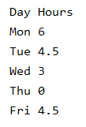
Nested sequences (List and Tuple)
1 List with hours of lessons per day
By using nested lists it’s more clear which data belongs together. The result is a nested list where each element in that list is a list itself.
list_hours_day = ['Mon', 6, 'Tue', 4.5, 'Wed', 3, 'Thu', 0, 'Fri', 4.5]
hours_school_day = [['Mon', 6], ['Tue', 4.5], ['Wed', 3], ['Thu', 0], ['Fri', 4.5]] print('Day', 'Hours', sep='\t') for day_hours in hours_school_day: for item in day_hours: print(item, end='\t') print()

Slide 31

Tuple() and List() functions
You can use the “typecasting” functions int(), str(), float(), ... to convert a variable to a desired data type
You can also convert a range to a desired type: Tuple or List.
Example: generate with a range()
a list of the even numbers between 1 and 20
a tuple with the odd numbers between 1 and 20
even_numbers = list(range(2,21,2)) odd_numbers = tuple(range(1,21,2)) print(even_numbers) print(odd_numbers)

